Slide 1





YasudaBot Intelligent Cloud meets Japanese Comedy
Daiyu Hatakeyama
Bot Framework
Tsuyoshi Matsuzaki
Microservices
Madoka Chonan
Xamarin Client
Drew Robbins
DevOps & AzureML

Slide 2






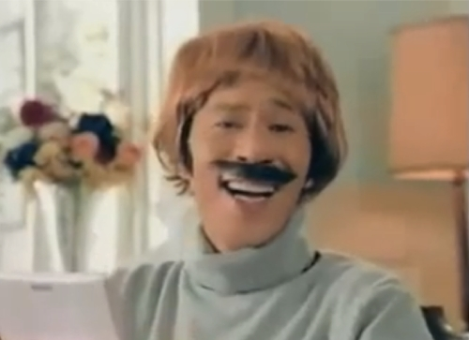

Lots of Japanese Comedy doesn’t export well from Japan.
But what if we could use the Intelligent Cloud to test and learn what content does work?
What does a 40-year old male in UK laugh at?
What does a 24-year old female in the US laugh at?

Slide 3
Solution
Yasuda-Bot serves up funny comedy sketches to users.
At set times in the sketch, it takes a picture of the viewer.
The picture is analyzed to see if the person is laughing, confused, etc.
We also collect location, approximate age and sex of the viewer.
This data is fed into an AzureML model to learn what comedy works well for each demographic.
Saving the world with Japanese Comedy.

Slide 4


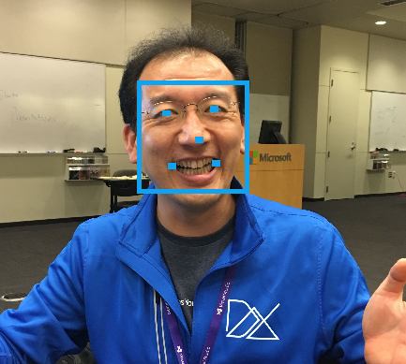
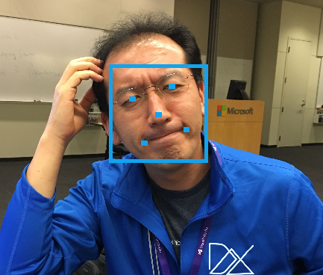
Design
Chat Client
“Show me a funny video”
Azure AppService
Cognitive Services
Azure Service Fabric
Face API
Traffic Manager
Service
Fabric
Xamarin Client
(iOS)
Emotion API
Xamarin Client
(Android)
Analysis
Chat Bot
Chat Bot
1
2
3
AzureML
Power BI
Web App
Microservice

Slide 5
Model data
Combine Facial recognition and Emotion API
1
"age": 45.5, "gender": "male“
Location: Redmond, WA
Source: Face API
2
Source: Device
3
"scores": { "anger": 2.90059546e-7, "contempt": 4.87637e-8, "disgust": 0.000007118697, "fear": 7.997454e-12, "happiness": 0.9999897, "neutral": 0.00000272383, "sadness": 1.04087668e-7, "surprise": 2.45461322e-8 }
"scores": { "anger": 0.143469959, "contempt": 0.1323704, "disgust": 0.0454723537, "fear": 0.00002107215, "happiness": 0.00112825842, "neutral": 0.385983467, "sadness": 0.291401178, "surprise": 0.000153323257 }
Source: Emotion API

Slide 6





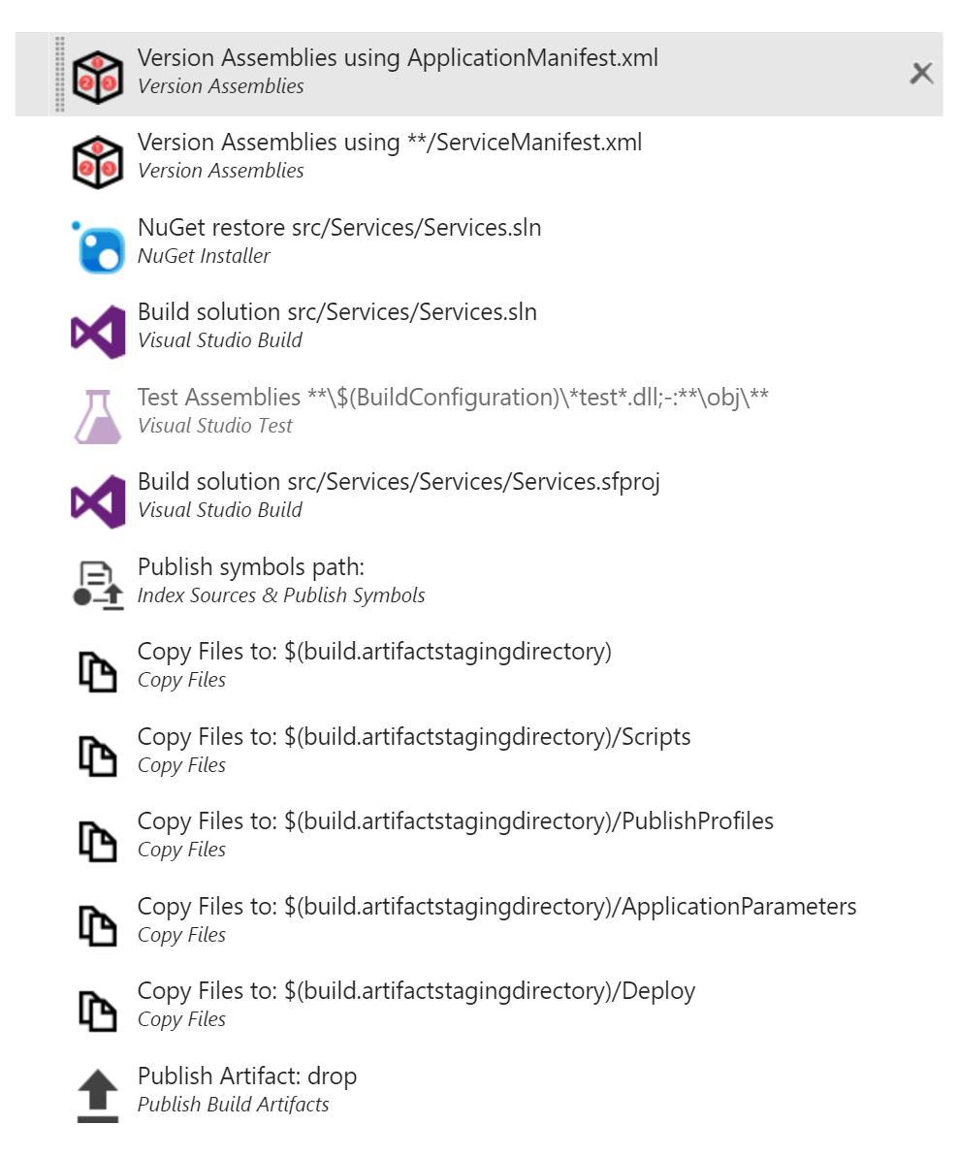
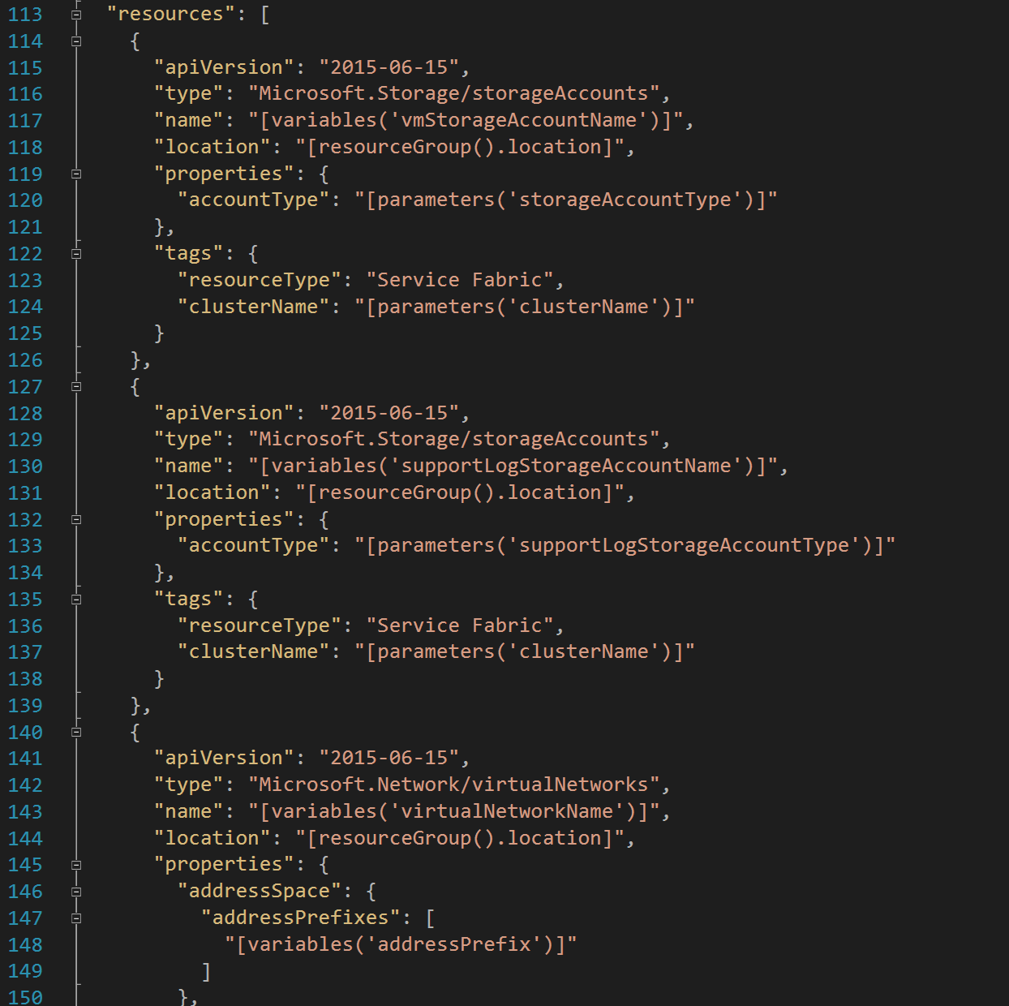
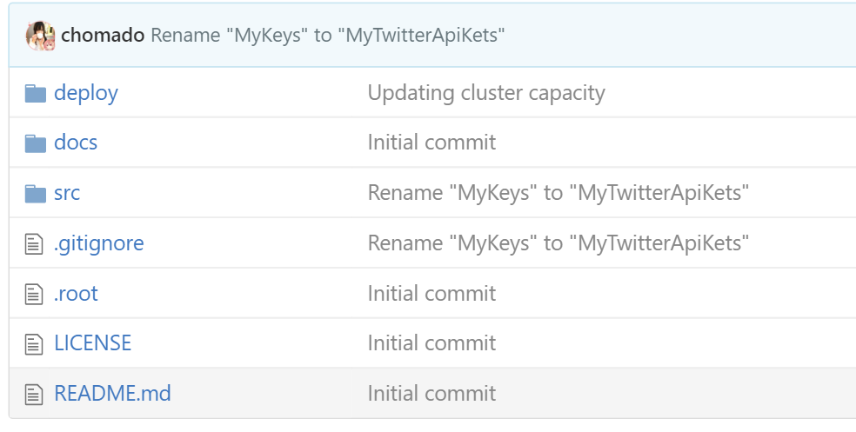
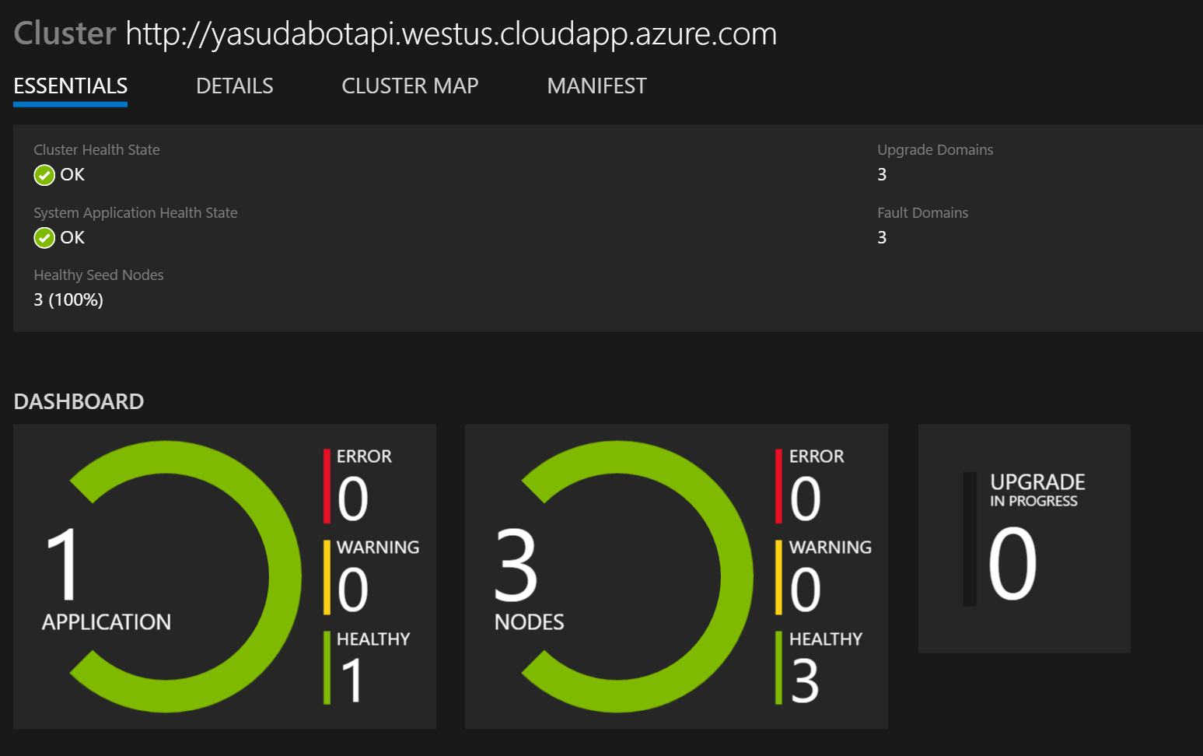
DevOps
GitHub:
Source Repository
Visual Studio Team Services:
Work tracking
Continuous Integration
Continuous Development
Microsoft Azure:
Azure Resource Groups
Traffic Manager – Hot swap
Application Insights
Service Fabric Explorer
Other:
Xamarin Test Cloud
HockeyApp
https://github.com/drewby/YasudaBot

Slide 7
Learnings

Slide 8
Bot Framework issues
ascend_bots@service.microsoft.com

